Slide 1


Collaboration in Ad Hoc Teamwork: Ambiguous Tasks, Roles, and Communication
Jonathan Grizou, Samuel Barrett
Peter Stone, Manuel Lopes

Slide 2
Ad Hoc Teamwork
Unknown Task, Team Role, Communication
Pursuit Domain
Method
Results
Limitations and future work

Slide 3
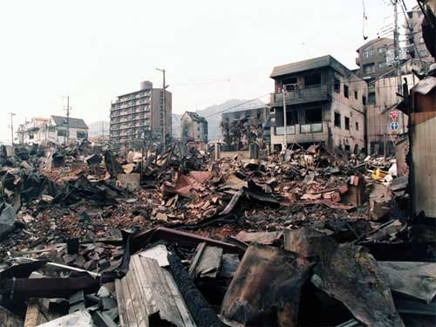
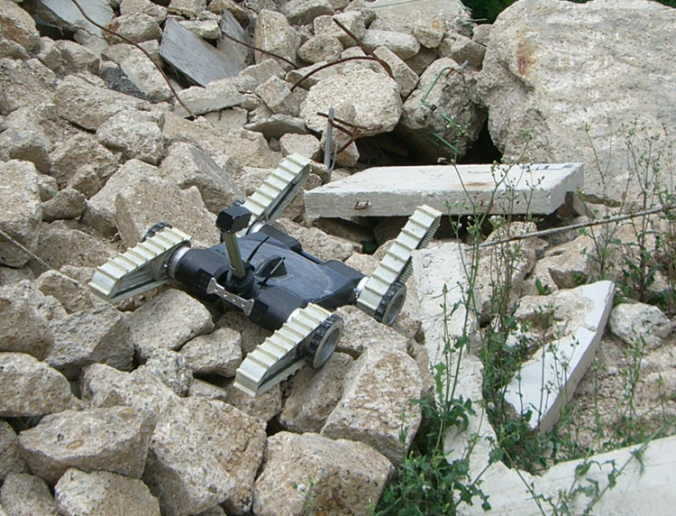
Ad Hoc Teamwork

Slide 4
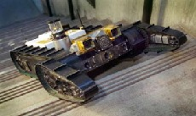
Ad Hoc Teamwork

Slide 5
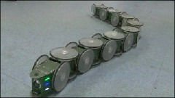
Ad Hoc Teamwork

Slide 6
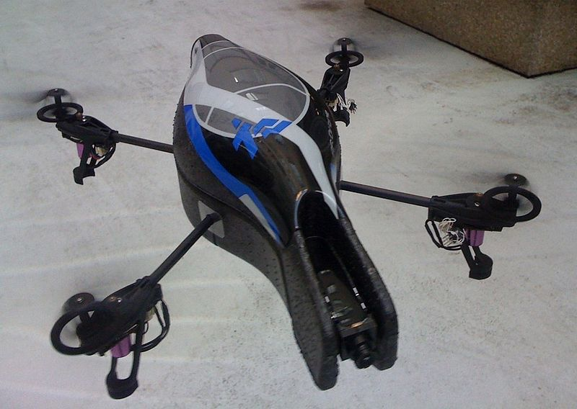
Ad Hoc Teamwork

Slide 7
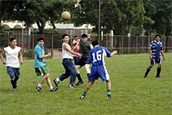

Ad Hoc Teamwork
Single agent control
Unknown teammates
Shared goals
No pre-coordination
Examples in humans:
Pick up soccer
Accident response

Slide 8
Ad Hoc Teamwork
Motivations
Agents more common and lasting longer
(both software and hardware)
Pre-coordination may not be possible
Agents should be robust to various teammates
Need to adapt quickly!

Slide 9
Ad Hoc Scenario
Team
Agent 1
Agent 2
Agent N
Reward
State
Joint Action
Environment
Notes:
Basic setting

Slide 10
Ad Hoc Agent
Ad Hoc Scenario
Team
Agent 1
Agent 2
Agent N
Reward
State
Joint Action
Environment
Notes:
Ad Hoc idea

Slide 11
Ad Hoc Scenario
Team
Agent 1
Ad Hoc Agent
Agent N
Reward
State
How good can it be?
Joint Action
Environment
Notes:
Evaluated by its performance wrt. the initial team member

Slide 12
Ad Hoc Scenario
Team
Agent 1
Agent 2
Agent N
Reward
State
Task known to the team
Joint Action
Environment
Notes:
From here we explain what have been done before, might be good to add references

Slide 13
Ad Hoc Scenario
Team
Agent 1
Ad Hoc Agent
Agent N
X
Reward
State
Task unknown to the new comer
Joint Action
Environment

Slide 14
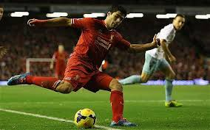
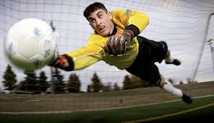
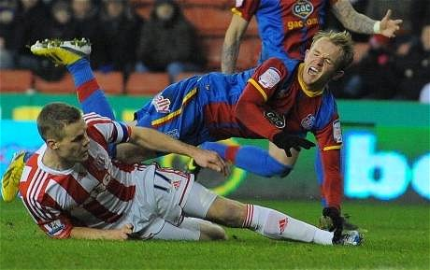
Ad Hoc Scenario
Team
Agent 1
Agent 2
Agent N
Reward
State
Role known within the team
Joint Action
Environment

Slide 15
Ad Hoc Scenario
Team
Agent 1
Ad Hoc Agent
Agent N
?
Reward
State
Role unknown to the new comer
Joint Action
Environment

Slide 16
Ad Hoc Scenario
Team
up
left
right
Agent 1
Agent 2
Agent N
Reward
State
Communication known to the team
Joint Action
Environment

Slide 17
Ad Hoc Scenario
Team
??
Ad Hoc Agent
??
??
Agent 1
Agent N
Reward
State
Communication unknown to the new comer
Joint Action
Environment

Slide 18
Ad Hoc Scenario
Team
??
??
??
Agent 1
Ad Hoc Agent
Agent N
?
X
Reward
State
Unknown task, role, and communication
Joint Action
Environment
Notes:
What we do in this work

Slide 19
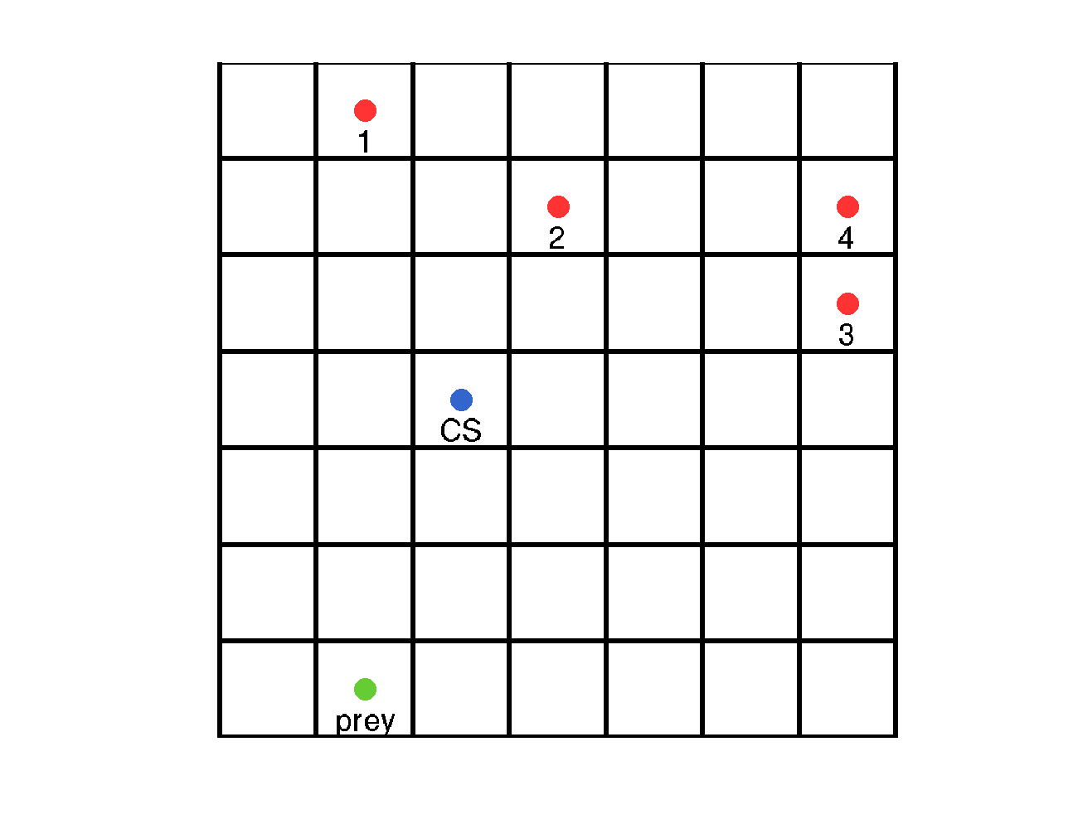
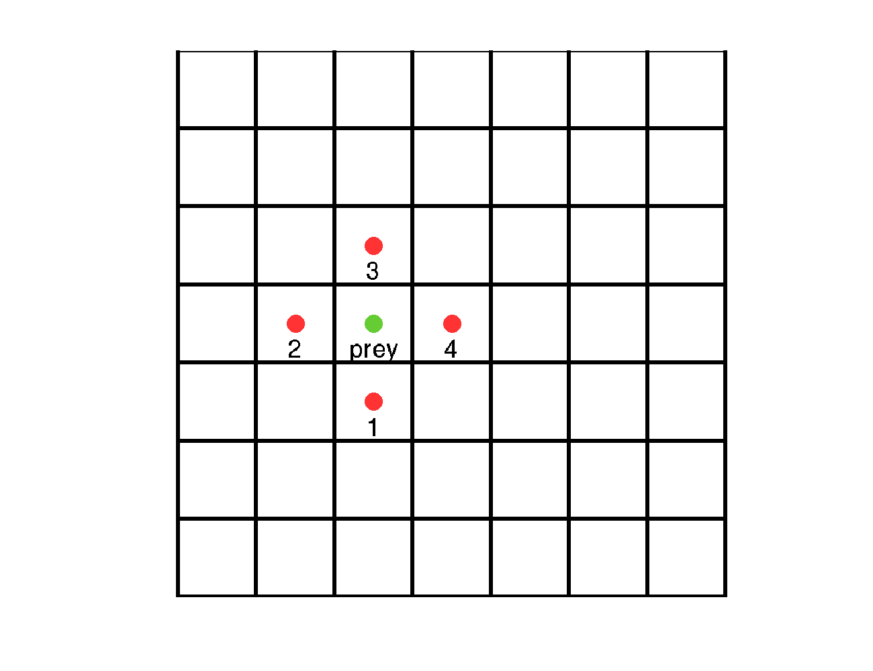
Pursuit Domain
7x7 toroidal grid
4 agents, 1 prey
Task: capture the prey at a specific position (CS)
Prey move to an open neighbouring cell

Slide 20
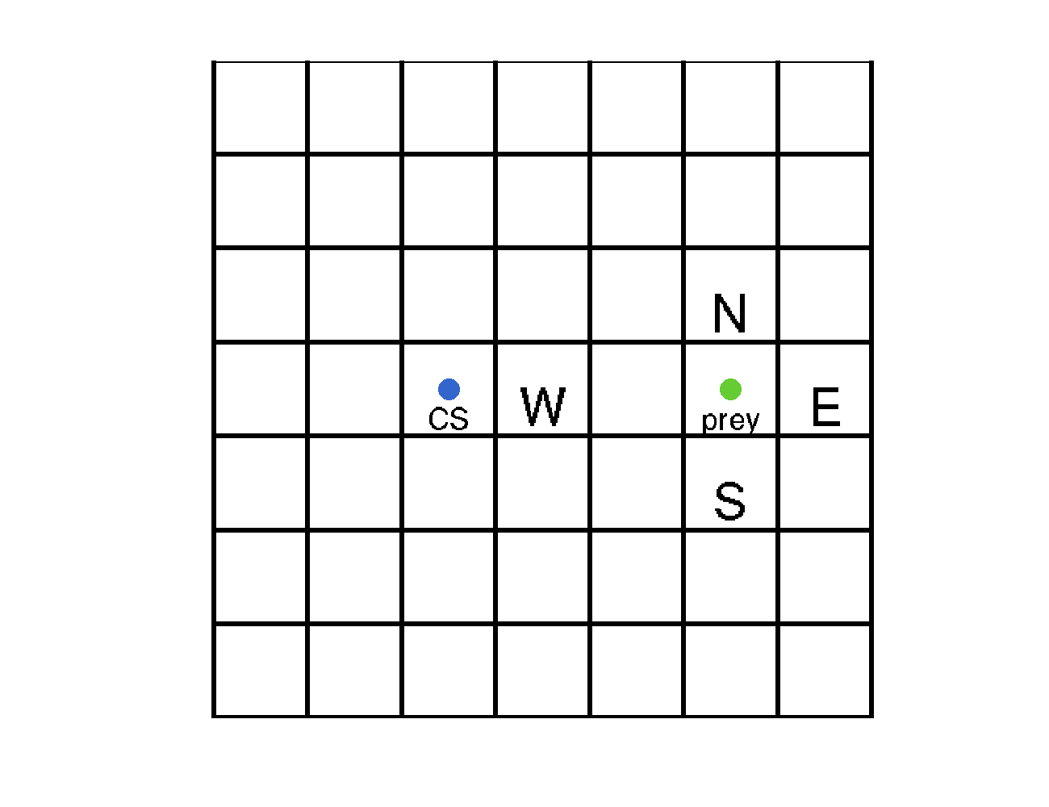
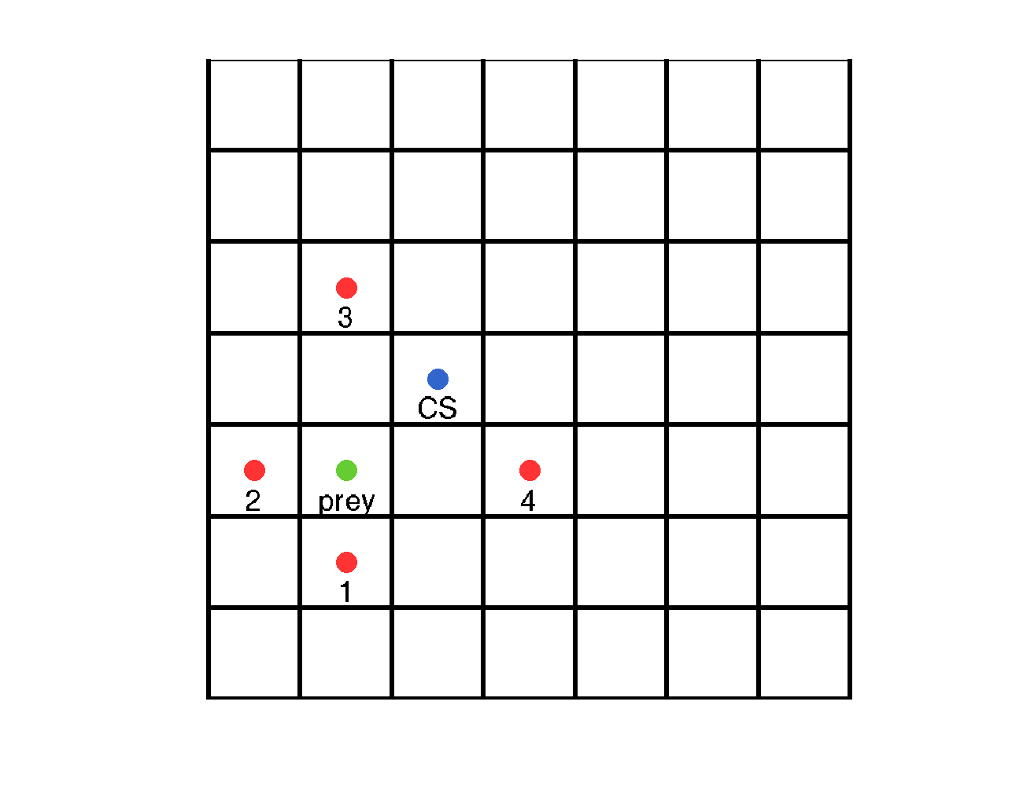
Team strategy
Agent are specialized to take the N, S, W, or E of the prey.
Constraining the prey to move in specific directions.
N,S,E,W depends on capture state, prey state, and position of agents.
N,S,E,W represented as reward. Agent policy computed independently using RL (Q-Learning)

Slide 21
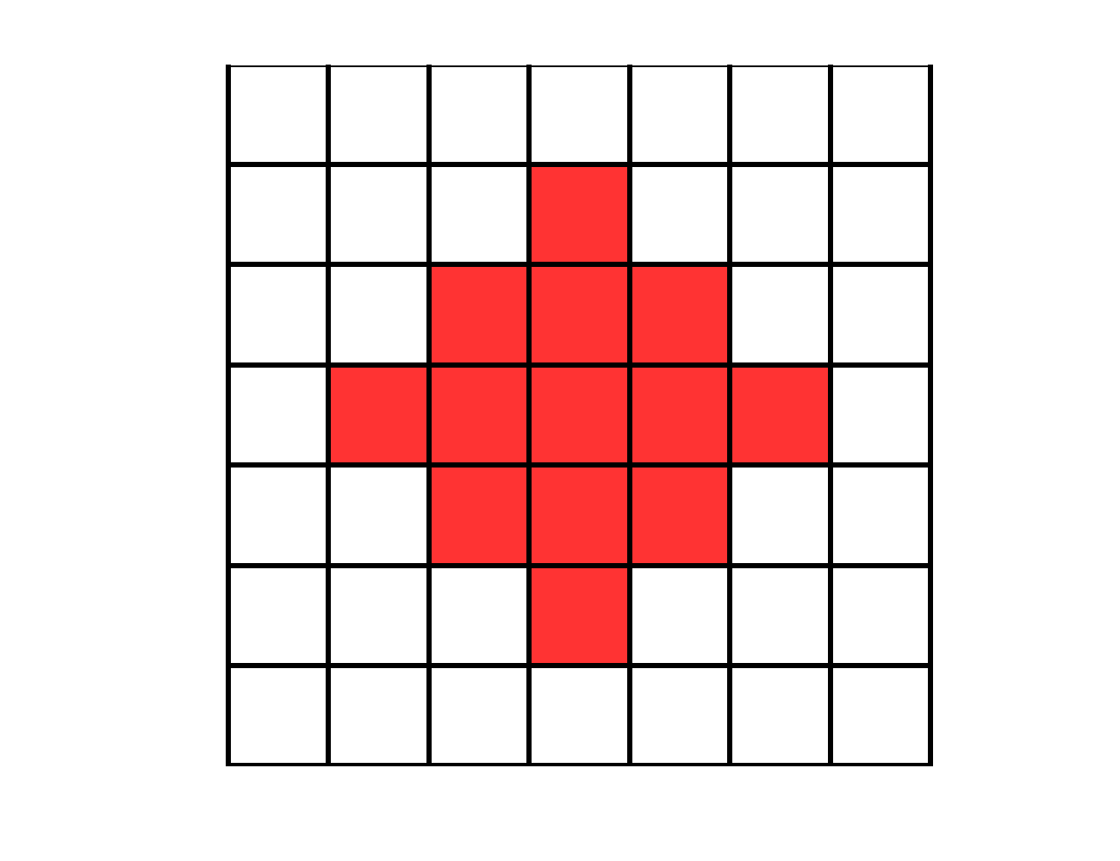
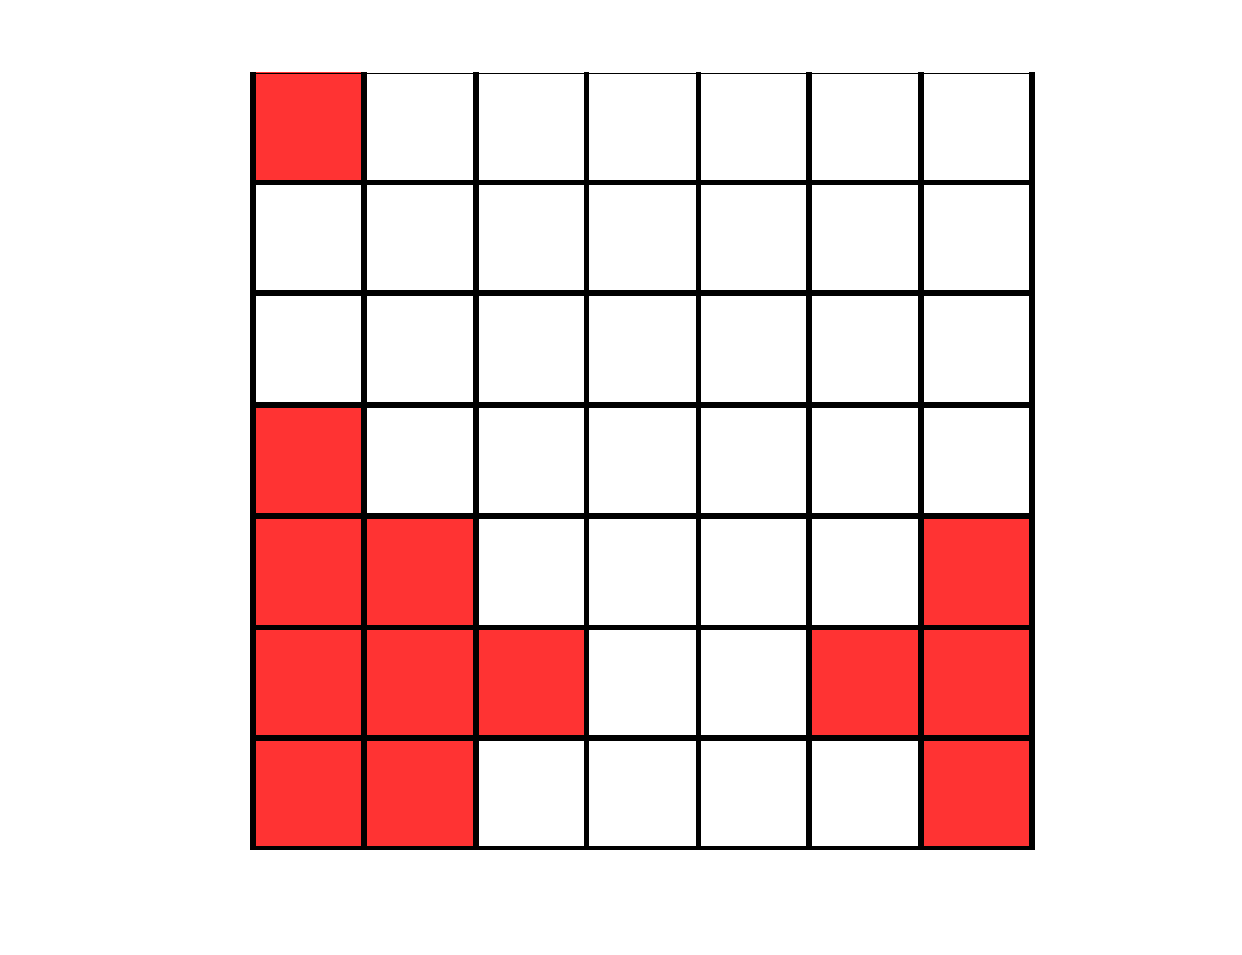
Partial observability
Agents see 2 steps away
Might not see the prey -> prey state becomes probabilistic (impacts planning)
Communication
Agents communicate about prey position

Slide 22
Domain variables
Different languages
Prey is in 21
Prey is in 4
Prey is in 43
Role of agents
N
S
W
E
Capture state
10 possible capture state
10 possible languages
10 possible team configuration
1000 hypothesis
Notes:
3 types of unknown, task, role, and communication
For communication, each cell is given a number randomly. A set of cell to number association is a language, there is many of such language, we pick 10.
Idem for others but easier to explain.

Slide 23
Noise
Actions outcome are noisy
Communication is noisy
Impacts
planning and inference
80% North
Uniform probability to refer to a neighbouring cell
10% West
10%
East
Notes:
Noise makes thing more difficult, costly to compute!

Slide 24
Method
A team B is made of n_B agents: B = {b_1, …, b_nB}
A domain d is made of:
An environment E made of n_S states, and where agents can perform n_U actions. Environment dynamics is known as an MDP.
A task τ, represented by a reward function R.
A team configuration κ, i.e. role given to each agent.
A communication protocol ρ, i.e. agent language. We denote m_b as the message of an agent b.
A domain, d={E, τ, κ, ρ}, is a subset of all possible domains D.

Slide 25
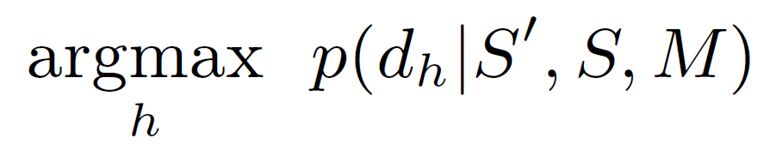
Method
We assume a finite set of task, role, and communication protocol -> finite set of hypotheses {d_1, .., d_h}.
Ad Hoc can observe positions of all agents (S and S’) and their messages M
(and sometimes the prey position)
We can use probabilistic update rules
Find the one that maximizes:

Slide 26
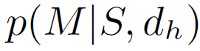
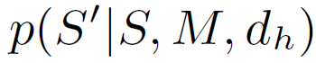
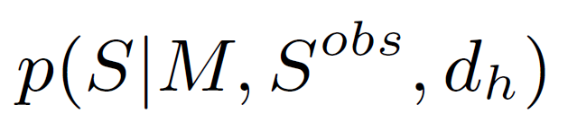
Method
Two sources of information
Messages
Probability of next state given initial state and messages
Provides information on the communication system
Refines estimation of prey state
(for partial observability)
Provides information on
the task and roles

Slide 27
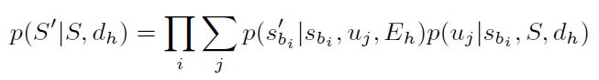
Method
Proba of next state given state for a given hypothesis
Over each agent
Over each action
Proba of next state for one agent, one action given the environment
Proba of action for this agent, given state of agents and domain hypothesis
Agents select their action independently
Notes:
If asked about messages, this is for full observability. When not full observability we have to compute probability of prey state before and as seen for each agent.
Also left most proba s_{b_i} is actually part of S but it is like that to be easier to read. Proba of action of agent b_i given its position and the position of the others and the domain hypothesis considered.

Slide 28
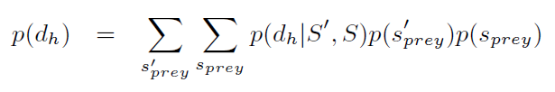
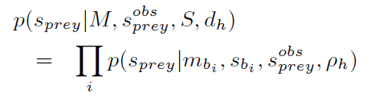
Method
Proba map of where the prey might have been before
Proba map of where the prey might be now
Equation for full observability
Updated given :
message
states of agents
observed or not position of the prey
hypotheses of communication protocol
Taking into account:
knowledge of the prey policy
noise in communication
Agents communicate independently
Notes:
This is when things get messy using communication, many cases to take into account + noise!!

Slide 29
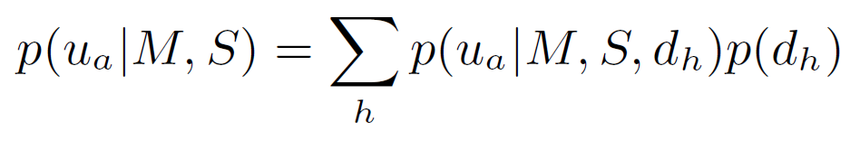
Planning
Ad Hoc agent weights policies of each hypothesis
according to their probabilities
Ad Hoc policy
Proba of hypothesis
Sum over all hypothesis
Hypothesis policy
Notes:
Simple weighted policy

Slide 30
Evaluation
Run for 200 steps
Average over 1000 experiments
Count the number of time a prey is captured
Reset to random position after each capture
Compare original team and ad hoc team

Slide 31
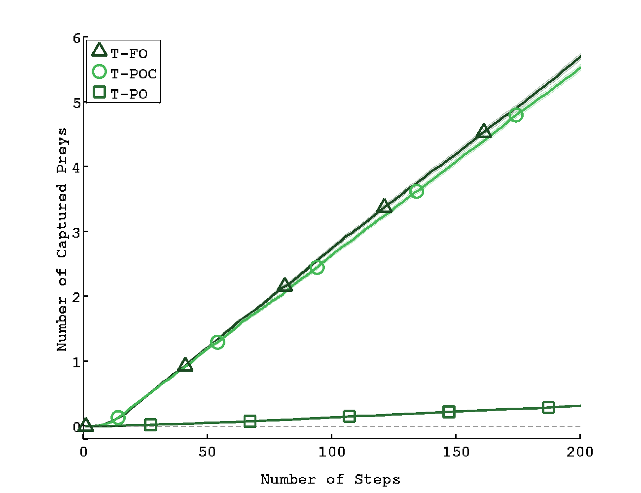
Default team
Full observability
Partial observability
+
communication
Partial observability
Notes:
The default team, no ad hoc agent, showing that communication is necessary when partial observability

Slide 32
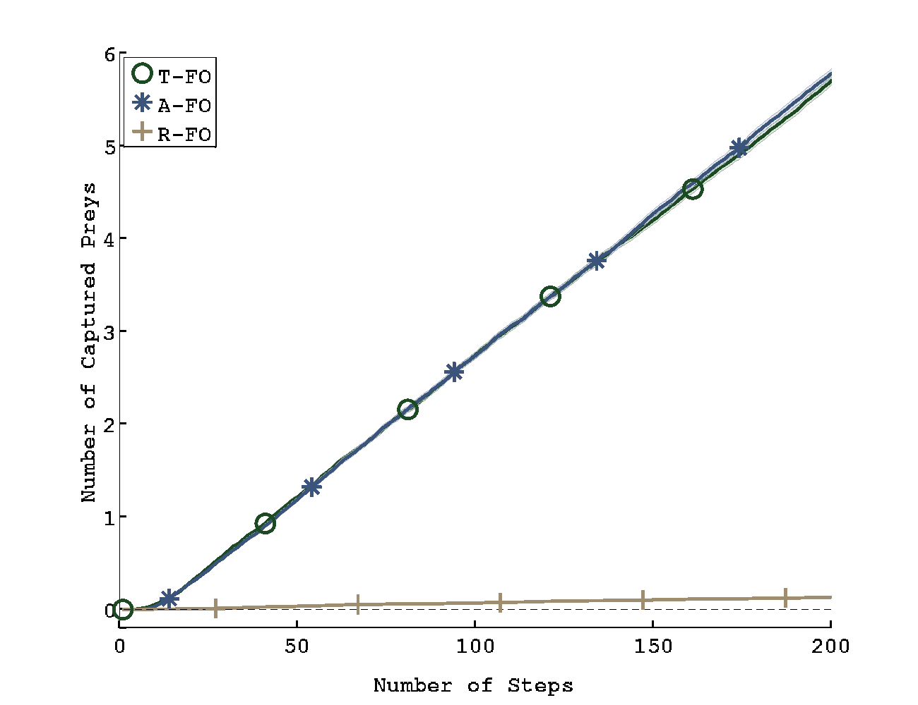
Full observability
Ad Hoc agent can match with the team seamlessly
Notes:
Full observability, it works fine

Slide 33
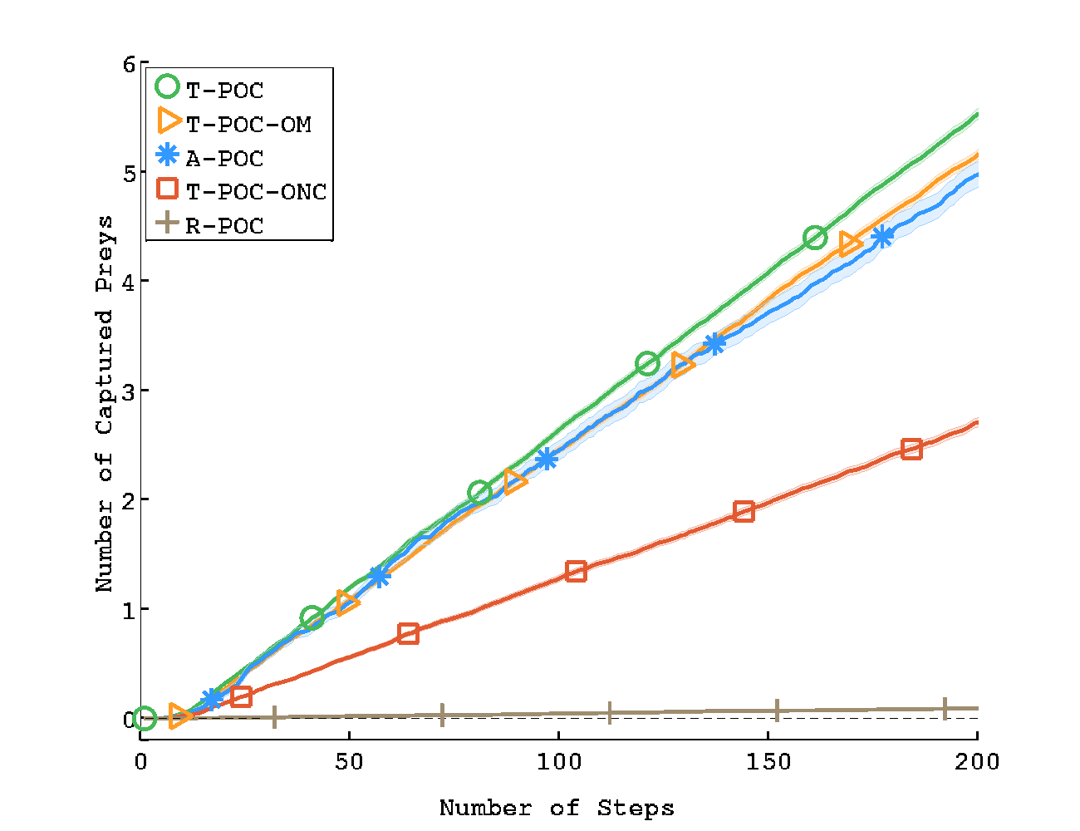
Partial observability
Default team
Default team, one agent does not speak
With Ad Hoc agent (does not speak but listen)
Default team, one agent neither speak nor listen
Notes:
Ad Hoc does not communicate. It reaches similar performance as a team with an agent that does not communicate but listen. And way better that an agent that does not listen and does not communicate.

Slide 34
Conclusion
An Ad Hoc agent can integrate into a team without knowing the task, its role, and the communication protocol.
We assumed a finite and known set of possible task, role, and communication.
First time these three aspects are considered simultaneously in an ad hoc setting.

Slide 35
Limitations and future work
Finite (and relatively small) set of hypotheses
Yet huge computational time in the first few steps
(many many probable cases to evaluate)
Try sampling based method

Slide 36
Limitations and future work
Default team strategy is not optimal
Our adhoc agent can have similar performance despite not performing the same action in the first steps!
Use more advance planning methods for the team

Slide 37
Collaboration in Ad Hoc Teamwork: Ambiguous Tasks, Roles, and Communication
Jonathan Grizou, Samuel Barrett
Peter Stone, Manuel Lopes
Code available online at:
https://github.com/jgrizou/adhoc_com

